Slide 1

Chapter 9
CSC 304
Professor Lucci
Lesson 10:
Regular Expressions and Finite Automata

Slide 2
Deterministic Finite Automata (DFA)
M = < Q,Σ, q_{init}, F, δ_{M}>
Σ is the input alphabet
Q is a finite set of states
q_{init} is the initial state(often denoted as q₀)
F⊆Q – set of accepting states
δ_{M} – transition function
where δ_{M} : Q x Σ → Q

Slide 3
Deterministic Finite Automata (DFA)
Examples
L₁ = {ω∈{a,b}* | n_{a}(ω) is odd}
L₂ = {ω∈{a,b}* | n_{a}(ω) is odd and n_{b}(ω) is even}
L₃ = {The set of all words over Σ= {a,b} that have a different first and last letter
L₄ = {ω∈{a,b}* | ω ends with ‘ab’}
L₅ = {ω∈{a,b}* | ω does not end with ‘ab’}

Slide 4
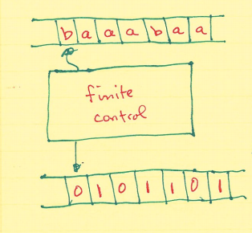
Deterministic Finite Automata (DFA)
input tape : read head may only move to the right
output tape : providing answers to the membership question
Membership Question: Does the input string, ω, belong to the language, L?

Slide 5
Deterministic Finite Automata (DFA)
Does the input string, ω, belong to the language, L?
We will observe that for the class of languages where finite automata are used (i.e. the class of regular languages), this question is always decidable.

Slide 6
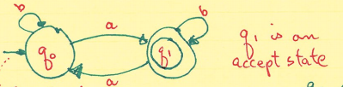
Deterministic Finite Automata (DFA)
L₁ = {ω | ω∈{a,b}* | n_{a}(ω) is odd}
M₁:
q₀ is the initial state
→ is the start symbol
q₀ remembers that “a-parity” is even
q₁ remembers that “a-parity” is odd

Slide 7
Deterministic Finite Automata (DFA)
Instantaneous description of computation
(q₀, baaabaa) --| (q₀, aaabaa)
(q₀, aaabaa) --| (q₁, aabaa)
(q₁, aabaa) --| (q₀, abaa)
(q₀, abaa) --| (q₁, baa)
(q₁, baa) --| (q₁, aa)
(q₁,aa) --| (q₀,a)
(q₀,a) --| (q₁, ε)

Slide 8
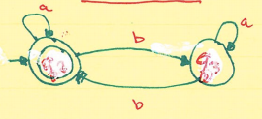
Deterministic Finite Automata (DFA)
L₂ = {even # of b’s and odd # of a’s}
A two state machine can remember two things
q₂ : the parity of b’s is even
q₃ : the parity of b’s is odd
In L₂ we must also keep track of the a-parity. Like above, this would also require two states, so in total there will be four states for L₂.

Slide 9
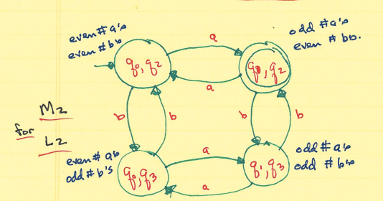
Deterministic Finite Automata (DFA)
The product of two automata L₁xL₂
Q = {q₀,q₁} x {q₂,q₃}

Slide 10
Deterministic Finite Automata (DFA)
n_{a}(ω) odd – the right “hemisphere”
n_{a}ω) even – the left side
n_{b}(ω) even – northern hemisphere
n_{b}(ω) odd – southern hemisphere

Slide 11
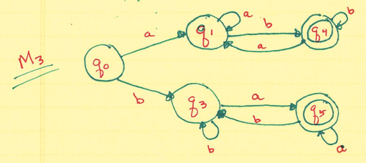
Deterministic Finite Automata (DFA)
L₃ – {All words over {a,b} with different first and last letters}
q₄ : words begin with ‘a’ and end with ‘b’
q₅ : words begin with ‘b’ and end with ‘a’
‘aababb’ and ‘bbaaba’ both belong to L₃
‘aba’ and ‘bbab’ do not belong to L₃

Slide 12
Deterministic Finite Automata (DFA)
Computational Trace
(q₀, aababb) --| (q₁, ababb)
(q₁, ababb) --| (q₁, babb)
(q₁, babb) --| (q₄, abb)
(q₄, abb) --| (q₁, bb)
(q₁, bb) --| (q₄, b)
(q₄, b) --| (q₄, ε)
ε- indicates string has
been entirely processed
q₄– an accept state
No characters are being erased. Since an FA never moves left there is no need to retain symbols in a traceonce they are processed.

Slide 13
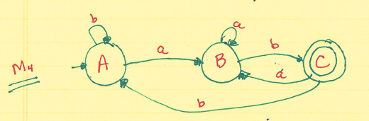
Deterministic Finite Automata (DFA)
L₄ : {words over {a,b}* that end with ‘ab’}
state A – the prefix ∈ of ‘ab’ has been scanned
state B – the prefix ‘a’ of ‘ab’ is a suffix of the input string
state C – the prefix ‘ab’ has been scanned

Slide 14
Deterministic Finite Automata (DFA)
L₅ : { ω∈ {a,b}* | ω does not end in ‘ab’}
How would you obtain M₅ for L₅ from M₄ from above.
Note: The class of languages that finite acceptors can recognize is called the class of Regular Languages.
As a consequence of your work constructing M₅, you should be ready to accept that :
This class of Regular Languages is closed under concatenation.

Slide 15
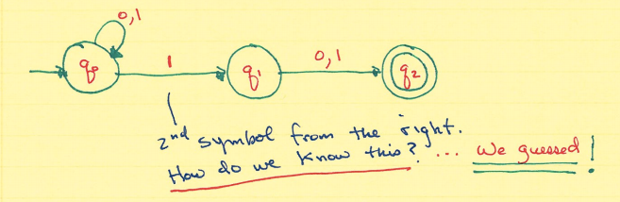
Nondeterministic Finite Automata (NFA)
Consider the language L = {ω∈ {0,1}* | the second symbol form the right is a ‘1’}
If we were allowed to guess, this problem becomes somewhat simpler.

Slide 16
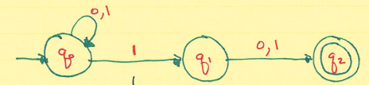
Nondeterministic Finite Automata (NFA)
How do we process a string in an NFA?
We must try every possible path thru the machine. If one or more culminates at an accept state, then ω∈ L(M).
We must try every path before deciding if an input belongs to L.
011∈ L(M)???

Slide 17
Nondeterministic Finite Automata (NFA)
011∈ L(M)???
(q₀, 011) --| (q₀,11) --| (q₀, 1) --| (q₀, ε) NO!
(q₀, 011) --| (q₀, 11) --| (q₀, 1) --| (q₁, ε) NO!
(q₁, 011) --| (q₀, 11) --| (q₁, q) --| (q₂, ε) YES!
Since we were able to find a path for 011, then 011 does belong to L(M).

Slide 18
Nondeterministic Finite Automata (NFA)
It appears that NFA’s are easier to construct(less software development time) but require more time to use(greater running time).
Note : You should be able to design a DFA for the previous language.

Slide 19
Nondeterministic Finite Automata (NFA)
Construct an NFA for L ={ω∈ {0,1}* | some pair of 0’s is separated by a string of length 3i for i >=0}
Start by listing a few string that are in the language and are not in the language
’00’, ‘01110’, ‘01010’ are in L
‘0110’, ‘010111110’ are not in L

Slide 20
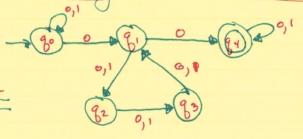
Nondeterministic Finite Automata (NFA)
How would you build a DFA for this example.
Process a few strings on this machine.

Slide 21
Nondeterministic Finite Automata (NFA)
Formal Definition of an NFA
M = <Σ, Q, q_{init}, F, δm>
Σ, Q, q_{init}, F are the same as before
δ_{M} : Q x Σ→ 2^Q // 2^Q is the power set of Q
Time Complexity
To process a string w with a DFA
tm = Θ(|ω|)
To process a string w with an NFA
Somewhat slower ….. But how much?

Slide 22
Nondeterministic Finite Automata (NFA)
We claim that NFA’_{s} are equivalent to DFA’_{s}.
What does this means?
How would we go about proving this equivalence?
NFA ≅ DFA
What does this mean?
How do we prove this?

Slide 23
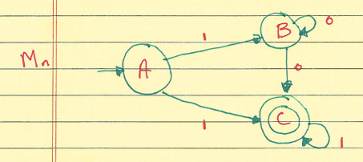
Nondeterministic Finite Automata (NFA)
Consider the following NFA
M = <Q,Σ, q_{init}, F, δ>
δ: Q x Σ → 2^Q
δ(A,1) = (B,C)
δ(C,0) = { }

Slide 24
Nondeterministic Finite Automata (NFA)
Coping with uncertainty
Quantum physics – Heisenberg’s uncertainty principle
Subatomic particles – momentum vs position
Parallel worlds – when there is a choice the universe bifurtes(Wheeler)

Slide 25
NFA≅DFA
Def: The reachable set X[ω] for the string w, is the set of states that M might be in (having started in the initial state) and having processed ω.

Slide 26
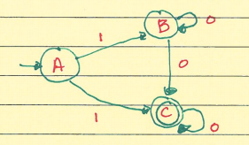
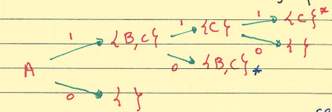
NFA ≅ DFA
When there is a repetition of a set on a path, you can stop that path.
X[1] = {B,C}
X[0] = { }
X[10] = δ({B},0) U δ({C},0)
= {B,C} U {C}

Slide 27
NFA ≅ DFA
We will equate a state in the equivalent DFA with each reachable set in the NFA.
L(M) is in general, infinite.
How can we be sure that the number of reachable sets is finite.

Slide 28
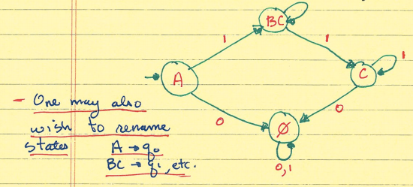
NFA ≅ DFA
Which states are the accepting states.
We have shown that any NFA can be emulated by a DFA.

Slide 29
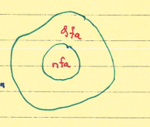
NFA ≅ DFA
Perhaps DFA_{s} are more powerful than NFA_{s}.
To prove equivalence of these two models we must also show that for an arbitrary DFA, we can always construct an equivalent NFA.

Slide 30
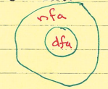
NFA ≅ DFA
But every DFA is also an NFA from the definition.
Hence NFA ≅ DFA(antisymmetry)
We have proven that NFA_{s} and DFA_{s} are equivalent models of computation(i.e. both models accept the same class of languages, the regular languages.)

Slide 31
NFA ≅ DFA
We stated earlier that a DFA “processes a string” in time Θ(|ω|). i.e. a string w of length n requires precisely n computation steps(the constant c = 1)
An NFA may be sent into any of its Q states by a symbol in ω. Hence processing a string with an NFA reuires time :
Θ(|Q|^n) “big-oh” since this is worst case
Notes:
Marked for Correction: Theta --> Big O

Slide 32
NFA ≅ DFA
An NFA can be viewed as a design tool.
Solve the problem by constructing an NFA.
Then convert your NFA to a DFA to yield an efficient solution.

Slide 33
Finite Automata with ε- transitions
We allow one last extension to the finite acceptor model. Until now, for an FA to change states, it was required an input symbol be scanned.
We can now relax this condition by allowing our automaton to change states even though no input has been read. This model will be referred to as an FA with ε- transitions or merely as an ε- NFA

Slide 34
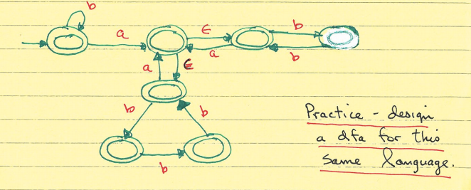
Finite Automata with ε- transitions
Design an ε-NFA for L = {a,b}* in which every pair of adjacent a’s is separated by a string of b’s of length 2i or 3i, i >=0
The strings ε, b, ba, baa, babbabbba belong to L
The strings aba, bababba, abbabbbbba do not

Slide 35
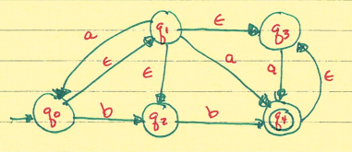
Finite Automata with ε- transitions
Consider the following ε-NFA
For a state q∈ Q, we define E(q) as the ε-closure of the state q
E(q) = {p∈ Q | (q, ε) |-- p} or E(q) is the closure of the set {q} under the relation {(p,r): there is a transition (p, ε,r) ∈ δ

Slide 36
Finite Automata with ε- transitions
E(q₀) = {q₀, q₁, q₂, q₃} as we can get to each of q₁, q₂, and q₃ from q₀ utilizing only ε- transitions.
Calculate E(q_{i}) for i=1,…,4 then find a and b successor for each state corresponding to the ε- closure of the states in this automaton.

Slide 37
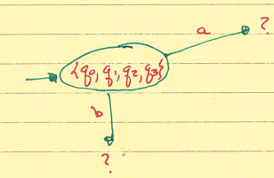
ε- NFA
Beginning the conversion of the previous ε- NFA to an FA without ε- transitions.
Once done, you will have that
NFA ≅ DFA ≅ ε-NFA
Therefore we can just speak of FA.
Try to finish the proof here.

Slide 38
ε- NFA
And coincidently, as we’ve mentioned several times, even permitting our FA-model to travel both left and right on its input tape adds nothing to the power of the model.

